Slide 1
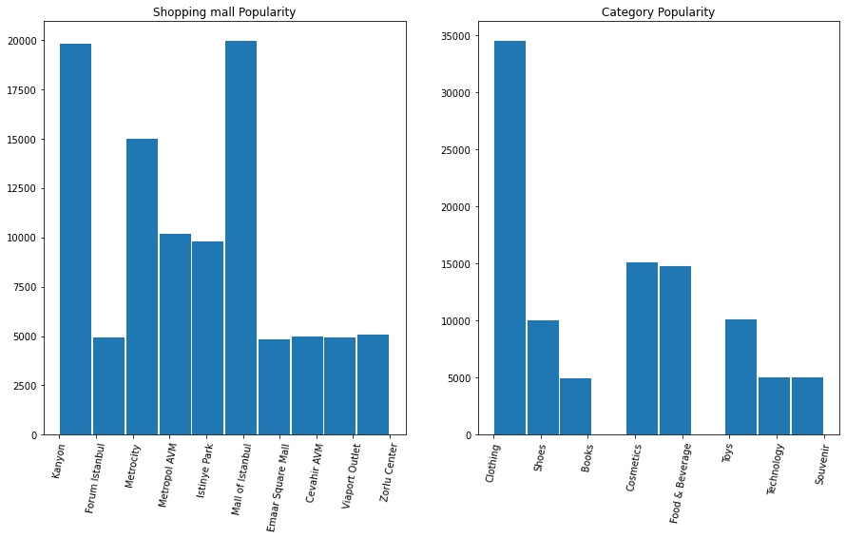
CUSTOMER SHOPPING ANALYTICS REPORT
The popularity of shopping malls among the dataset provided indicates that Kanyon and Mall of Instabul had the highest number of customers.
Clothing was the most preferred shopping category across the 10 malls under the study.
Cosmetics and food & beverages were relatively preferred after the clothing category.
Books had the least popularity in the dataset. They were only considered by approximately 5000 customers.

Slide 2
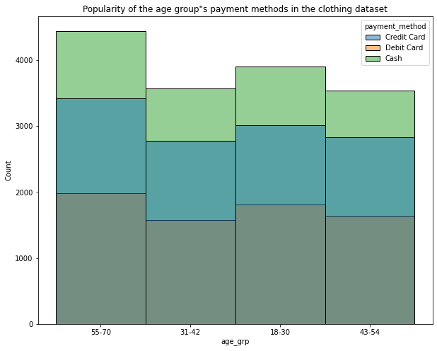
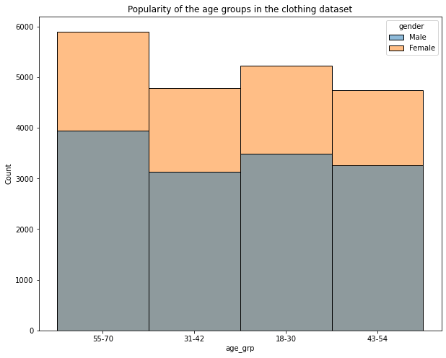
CLOTHING CATEGORY
Majority of the customers that did shopping for clothing were females across the 4 age groups
Between 55 years and 70 years we had the highest number of customers in both genders. The distribution of gender in this age group was 60% female ad 40% male.
Cash was the most preferred payment method for clothing followed by credit cards

Slide 3
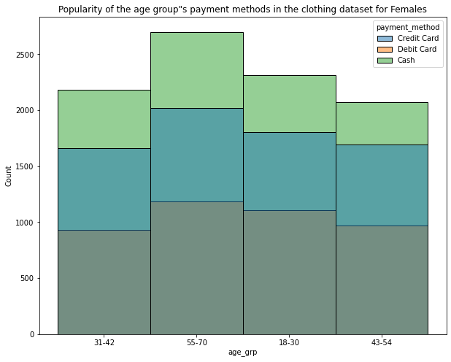
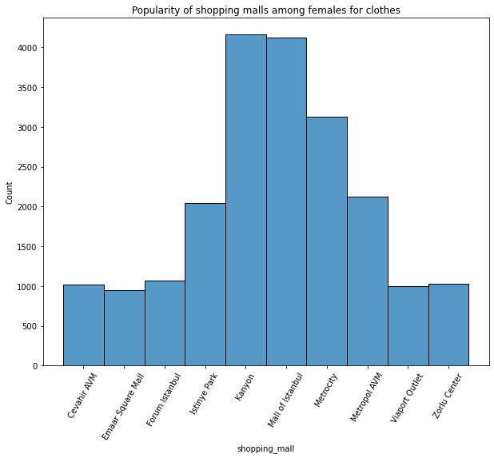
CLOTHING CATEGORY
Cash dominated in the female customers group for the clothing, Debit cards had the least popularity among the users.
The age group 55-70 years had the highest preferred rate for all modes of payment.
Kanyon and Mall of Instabul had their share of being the most preferred shopping malls for females doing clothing shopping.
The popularity of Kanyon and Mall of Instabul can be articulated to their physical locations having a large target market

Slide 4
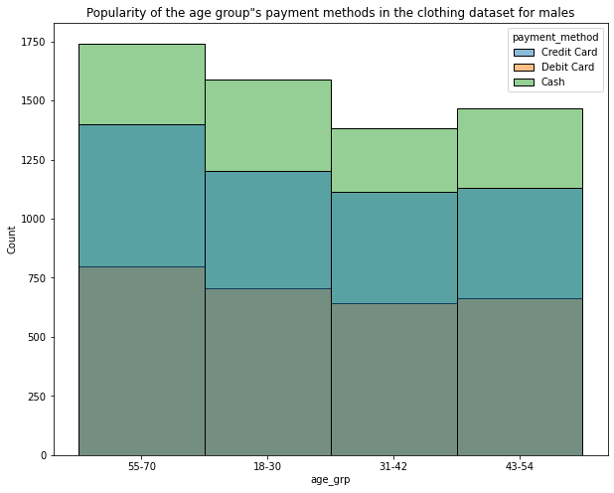
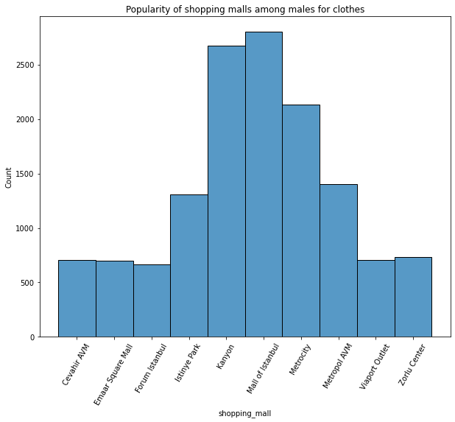
CLOTHING CATEGORY
Cash dominated in the male customers group for the clothing, Debit cards had the least popularity among the users.
The age group 55-70 years had the highest preferred rate for all modes of payment.
There is little fluctuation in the choice of payment method across the age groups. This can be observed from the graph and in comparison to the females.
Kanyon and Mall of Instabul had their share of being the most preferred shopping malls for males doing clothing shopping.

Slide 5
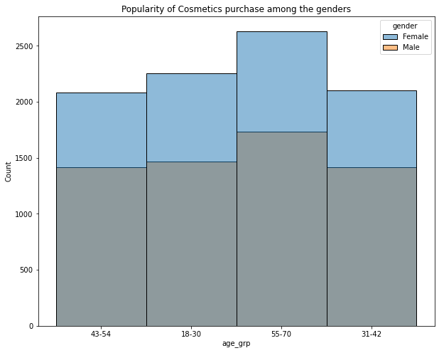
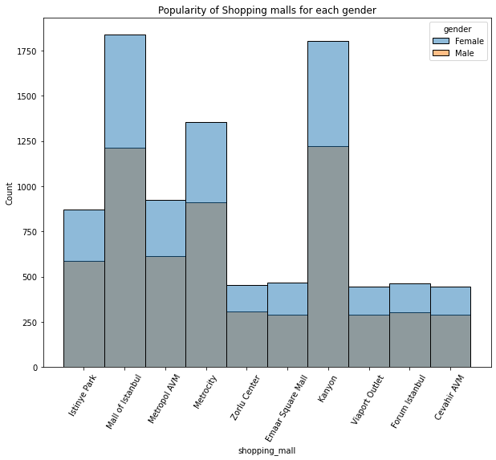
COSMETICS CATEGORY
Majority of the customers that did shopping for cosmetics were females across the 4 age groups
Between 55 years and 70 years we had the highest number of customers in both genders.
Kanyon and Mall of Instabul were the most preferred shopping mall for cosmetics in both genders.

Slide 6
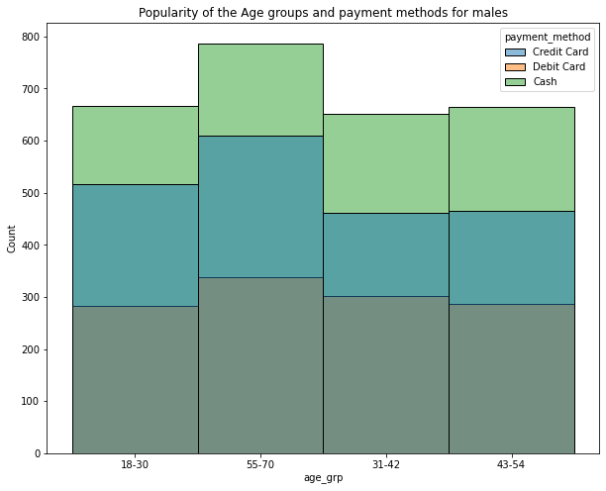
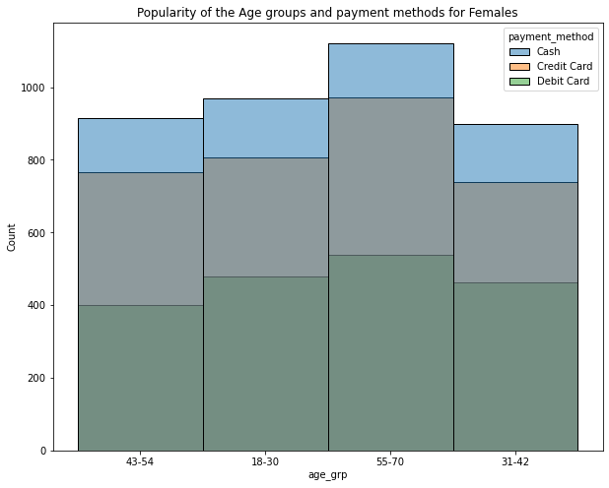
COSMETICS CATEGORY
Between the ages 55 years and 70 years, there was a high number of customers registered for cosmetic shopping for both females and males, with the females dominating the market.
The use of cash is notably high in both genders and highest in the age group 55-70 years. The use of credit cards was the second preferred option after cash in both genders.

Slide 7
THE END!!
THANK YOU!!
DONE AND COMPLETED IN PYTHON USING THE FOLLOWING LIBRARIES :
Matplotlib
Seaborn
Numpy
Pandas

